Slide 1

Lodge Hosting
JSL Entryway Host Greeting
Host Orientation/Kick Off
October 25, 26, 27 2024
Notes:
Use this as the last slide

Slide 2
JSL Host - Cheerful Welcome to JSL Guests
Clock in/out at Eagle - Wear high visibility vest
Check at JSL front desk when arriving and leaving
Stand next to the “Guests Only” sign about one car length into driveway entrance
Adapt location depending on weather, sun, traffic, etc.
Offer friendly greeting to every driver and vehicle
Politely restrict access to authorized vehicles
Send unauthorized vehicles around loop of JSL drive to exit
Notes:
Use this as the last slide

Slide 3
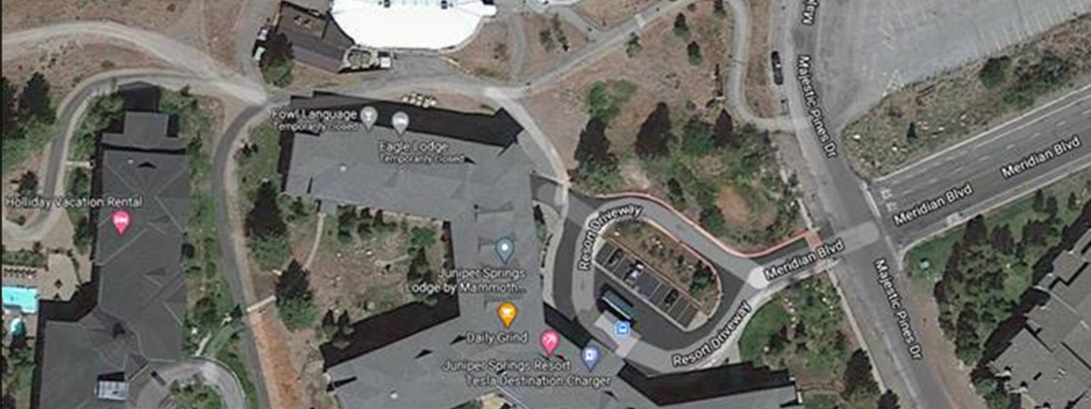
JSL Host Position
A
Notes:
Use this as the last slide

Slide 4
Vehicles Authorized to Enter the JSL Driveway
JSL guests, including those staying in properties above JSL
Emergency, police and fire vehicles
Buses, taxis, Uber, Lyft, and shuttles
Delivery vehicles both commercial and requested by a JSL guest (i.e. pizza, etc.)
Vehicles dropping off or picking up JSL (but not Eagle) employees
Mammoth Mountain vehicles, JSL vehicles and other repair or service vehicles
Notes:
Use this as the last slide

Slide 5
Important Safety & Functional Concerns
Host’s primary purpose is to ensure safe and smooth flow of vehicle and pedestrian traffic
Blinding sun to drivers
Uncontrolled pedestrian flow through and near intersection
U-turns in intersection by vehicles to park on Meridian
Drivers and pedestrians asking questions of the Host greeter – respond briefly and disengage quickly but politely
Don’t direct traffic in the intersection of Meridian and the Eagle parking lot entrance
Notes:
Use this as the last slide

Slide 6
Quiz Questions - 1
The most important aspect of JSL greeting is:
  Providing accurate information to all questions
  To ensure safe and smooth flow of vehicle and pedestrian traffic
  Prevent unauthorized vehicles from entering the JSL loop
  Allow only “Service Animals” into JSL
At the beginning of the shift the Host should:
  Clock-in at Eagle Lodge
  Move the Host Nametag to a high visibility vest to be worn during the shift
  Check in with the JSL Front Desk staff
  All of the above
Notes:
Use this as the last slide

Slide 7
Quiz Questions - 2
If it is snowing heavily the Host should:
  Consider driver visibility and adjust working position accordingly
  Direct traffic to help drivers avoid sliding into each other
  Ask the Front Desk staff if it is okay to leave early
  Wear appropriate clothing, googles and personal traction devises
  A and D
If a van with 8 members of a ski club arrives to unload passengers near the Eagle – JSL driveway the Host should:
  Demand that the vehicle leave immediately
  Allow the club members to unload this time only
  Direct the van around the loop to the Eagle parking drop-off area
Notes:
Use this as the last slide

Slide 8
Quiz 1 - Answers
The most important aspect of JSL greeting is:
  B - To ensure safe and smooth flow of vehicle and pedestrian traffic
At the beginning of the shift the Host should:
  D - All of the above
  Clock-in at Eagle Lodge
  Move the Host Nametag to a high visibility vest to be worn during the shift
  Check in with the JSL Front Desk staff
Notes:
Use this as the last slide

Slide 9
Quiz 2 - Answers
If it is snowing heavily the Host should:
  E – a) and d)
  a) Consider driver visibility and adjust working position accordingly
  d) Wear appropriate clothing, googles and personal traction devises
If a van with 8 members of a ski club arrives to unload passengers near the Eagle – JSL driveway the Host should:
  C - Direct the van around the loop to the Eagle parking drop-off area
Notes:
Use this as the last slide

Slide 10

Notes:
This is the intro/exit slide.

