Slide 1
ADVENTURE CENTER ACTIVITIES
SUMMER 2025
KICK OFF

Slide 2
A FEW
QUESTIONS TO ASK YOUR GUESTS
What kind of activities are you interested in?
We have:
  Mountain Biking
  Mountain Coaster
  Scenic Gondola
  Bus to Red’s Meadow-Devil’s Postpile
  Kid’s activities (climbing wall, ropes course, zipline, Woolly’s mining, SAFE Archery, Bungee Trampoline)
  Via Ferrata
  Hiking
  Kayaking and Paddle boarding
  Fishing
  Motor boat rentals
  Horseback riding
  Alpine Lake swimming
  Scenic drives
  Beaches
  Museums
  Village: Shopping, Restaurants, Gallery, Music events, and more

Slide 3
How far are you wanting to go on your hike? (So you can narrow down a list of possibilities)
Do you have water bottles, backpacks or fanny packs, hiking footwear, sunscreen and snacks? (If it’s obvious that they’re prepared, no need to ask this. But a lot of people aren’t prepared. So you can determine if they should even be hiking, what length they might be able to do, or if they should go buy stuff first)
How many days are you here? (So you can figure out how much time they have to do different activities. For example, if it’s overcast today, and they say they want to ride the gondola to the top, but they have 3 more days and it’s supposed to be sunny, recommend they do that tomorrow and figure something else out for them for today)
Where are you heading next from Mammoth? (So you can tell them about cool things to see along their way out of here. Going to LA? Stop by Red Rock Canyon State Park. Going to Vegas? Go through Death Valley and stop by Badwater Basin. Going to Reno? Stop by Mono Lake, Bodie or the Walker River)
Do you have a muzzle for your dog? (This question is for people taking the shuttle to Red’s Meadow. Muzzles are required on the bus for dogs, even most service dogs, no exceptions – unless they have a fully enclosed breathable crate for the dog which is rare. Backpacks don’t count. All ESTA buses require muzzles, including in town. They can be purchased here)

Slide 4
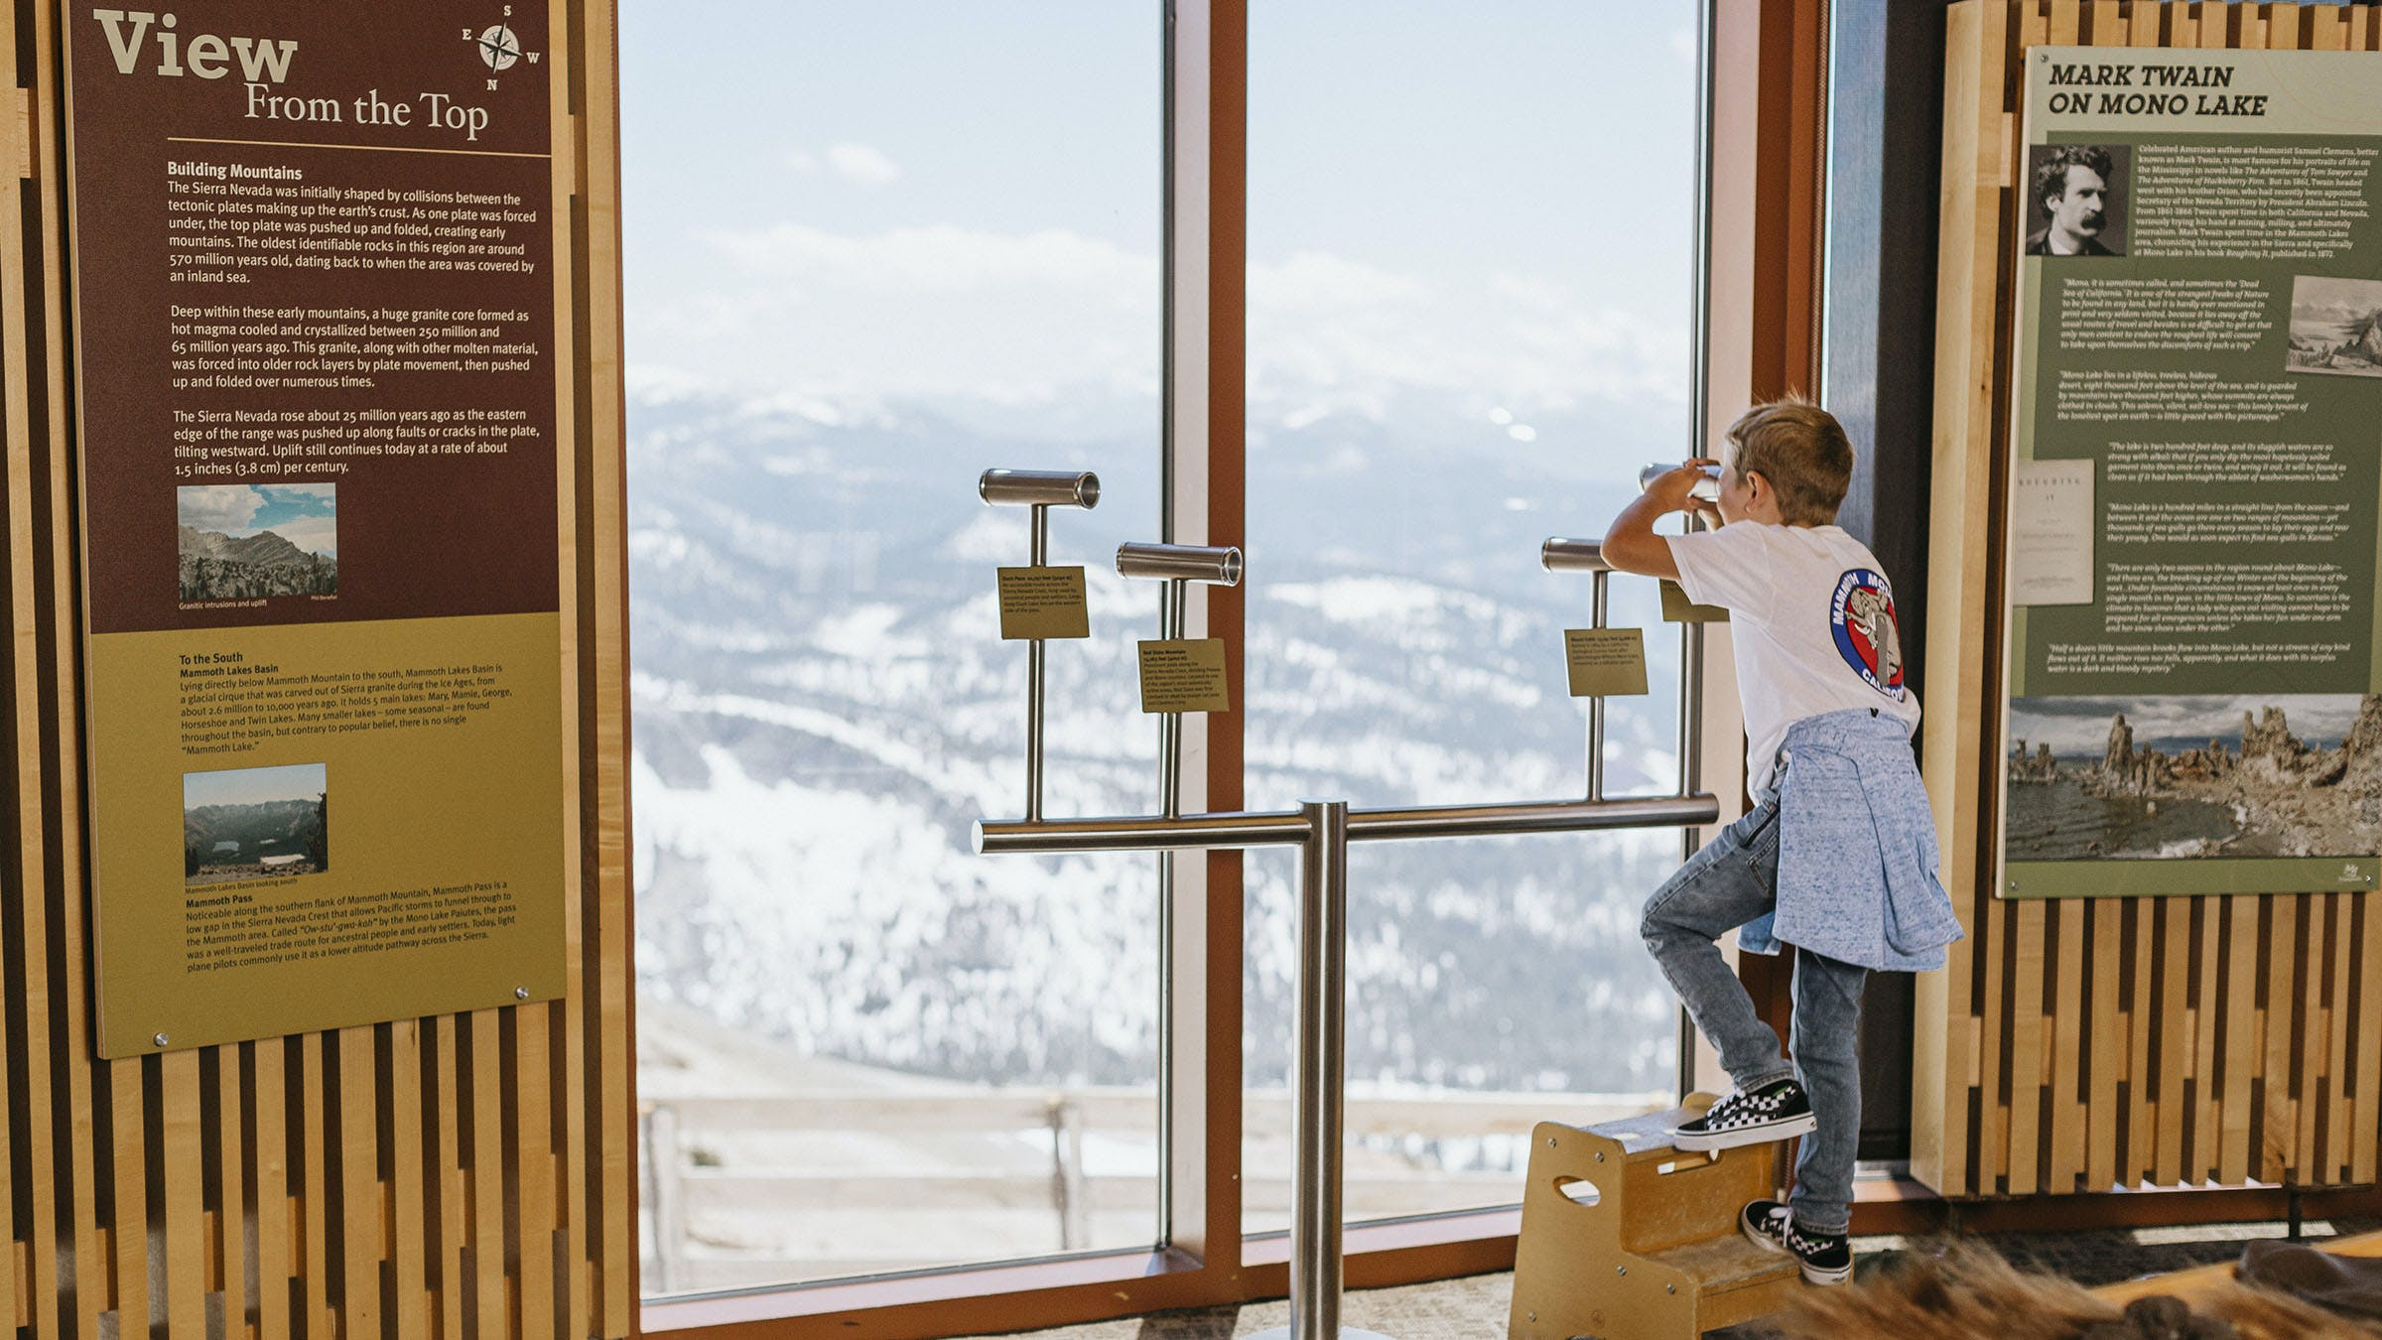
ELEVEN53 INTERPRETIVE CENTER & CAFÉ
Featuring exhibits for all ages, a knowledgeable docent, café and panoramic views of the Sierra and beyond. This is the central hub of the Explore Mammoth experience. Enjoy free access with your Scenic Gondola Ride ticket.
Exhibits change periodically. Topics may include volcanic history, geology and geography, weather patterns, cultural heritage, and natural history.
Enjoy lunch with a view at Eleven53 Café. Offering house-made sandwiches, soup, chili, and snacks.

Slide 5
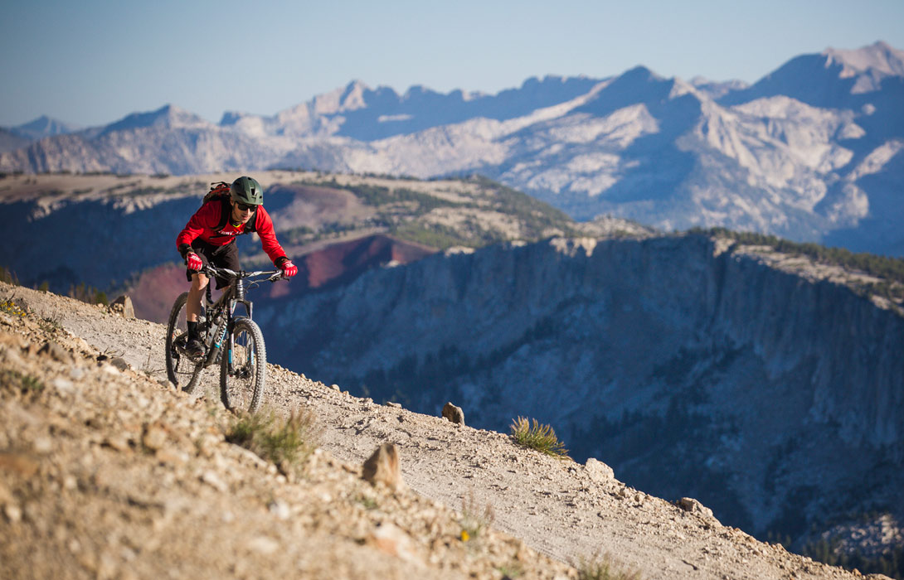
THE PREMIER BIKE PARK IN THE U.S.
Whether it’s your first time riding on dirt, or you’re a downhill wizard, the Mammoth Bike Park delivers the ultimate high-alpine riding experience for everyone. With 80+ miles of singletrack offering plenty of pavers, berms, jumps and drops, as well as our beginner-friendly Discovery Zone, there’s two-wheeled fun for all at the country’s premier lift-served bike park.

Slide 6
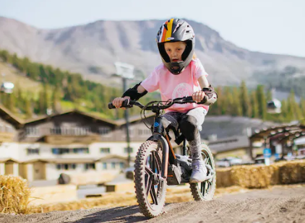
STACYC™ FULL THROTTLE PUMP TRACK
Hop on a STACYC™ powered stability cycle and take a spin around our pump track, where kids can get the feel for whoops, berms, and balance while having a blast. It's the perfect introduction to the Mammoth Bike Park for littler rippers.
Generally suitable for riders under 75 lbs. who are able to use a balance bike. Full-face helmets are required and available, although you are encouraged to bring your own.

Slide 7
HIKING TRAILS AT MAIN LODGE
MAIN LODGE TRAIL 2 MILES
ST ANTON TRAIL 3 MILES
OFF THE TOP MAMMOTH MTN TRAIL 5 MILES
TWIN LAKES TRAIL 3 MILES
MINARET TRAIL 1 ½ MILES
DISCOVERY TRAIL ½ MILE

Slide 8
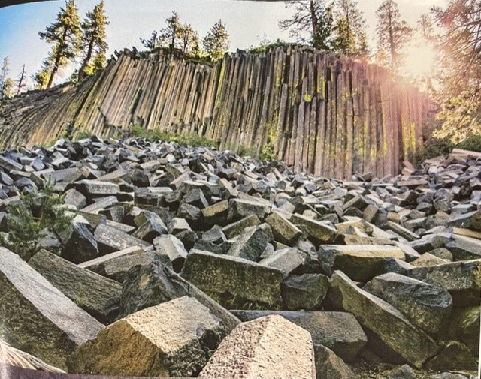
VISIT DEVILS POSTPILE, RAINBOW FALLS & REDS MEADOW
The majesty of these natural wonders lie just over the shoulder of Mammoth Mountain in the San Joaquin River Valley. To preserve its pristine nature, visitors must ride the shuttle for access to the Devils Postpile National Monument.
The Reds Meadow Valley Road to Devils Postpile National Monument is managed by the National Park Service and will be closed Mon-Thurs this summer for maintenance.
SHUTTLE PICK UP AREAS
ADVENTURE CENTER
The shuttle line starts at the Woolly Mammoth statue in front of the Adventure Center. Shuttles are loaded on a first-come basis for all ticket holders within a boarding window. Please note that you may not be able to board the first shuttle within your reserved boarding window.
THE VILLAGE
The Devils Postpile Shuttles will transport visitors from the Village at 7:15 AM, 8 AM and 8:45 AM. From 9:00 AM Friday to11PM Sunday–4:30 PM, visitors can use the free Bike Park Shuttle to get from The Village to the Adventure Center at Main Lodge, which departs every 15 minutes from Stop #90 on Canyon Blvd. Priority boarding is given to ticketed bike park passengers.
REDS MEADOW
Exiting the valley after 4:00 PM will result in longer wait times. The last bus departs Reds Meadow Resort at 7:00 PM Friday, Saturday and 11PM Sunday

Slide 9
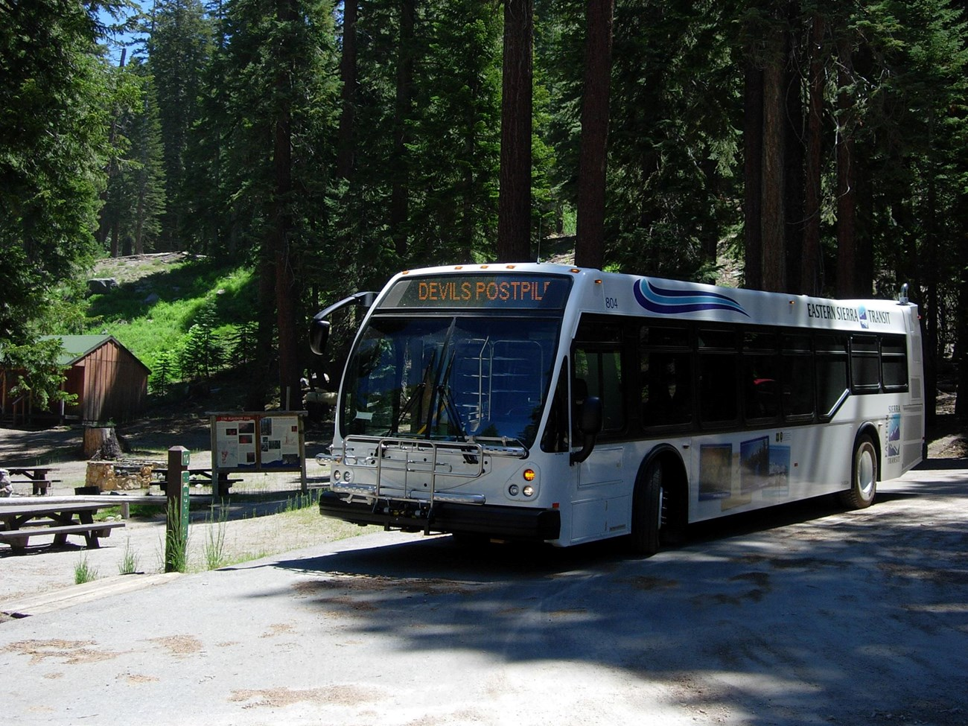
Exceptions to the red’s Meadow Shuttle
Vehicles entering area before 7AM or after 7 PM.
Vehicles transporting livestock, horse trailers, etc.
Vehicles carrying car top boats, canoes, kayaks, inflated float tubes.
Campers staying in the developed campsites in the valley (does NOT include Backpackers going into the backcountry).
Overnight resort guests and horseback riders.
Vehicles where a passenger has a handicapped placard/access pass.
Vehicles accompanied by a fishing guide authorized to do business in the valley.
Employees of Reds Resort, Devils Postpile, or the FS that live in the valley or are working on the valley in pay status (usually in Government Vehicle).
Any Federal, State, or local officer, or member of an organized rescue or fire fighting force in the performance of official duty.
Service vehicles having work in the valley (telephone co., delivery, tow trucks, etc.).
Any backpacker who are dropping off a food cache at Reds Meadow: they are only supposed to drop them off and then come right back.

Slide 10
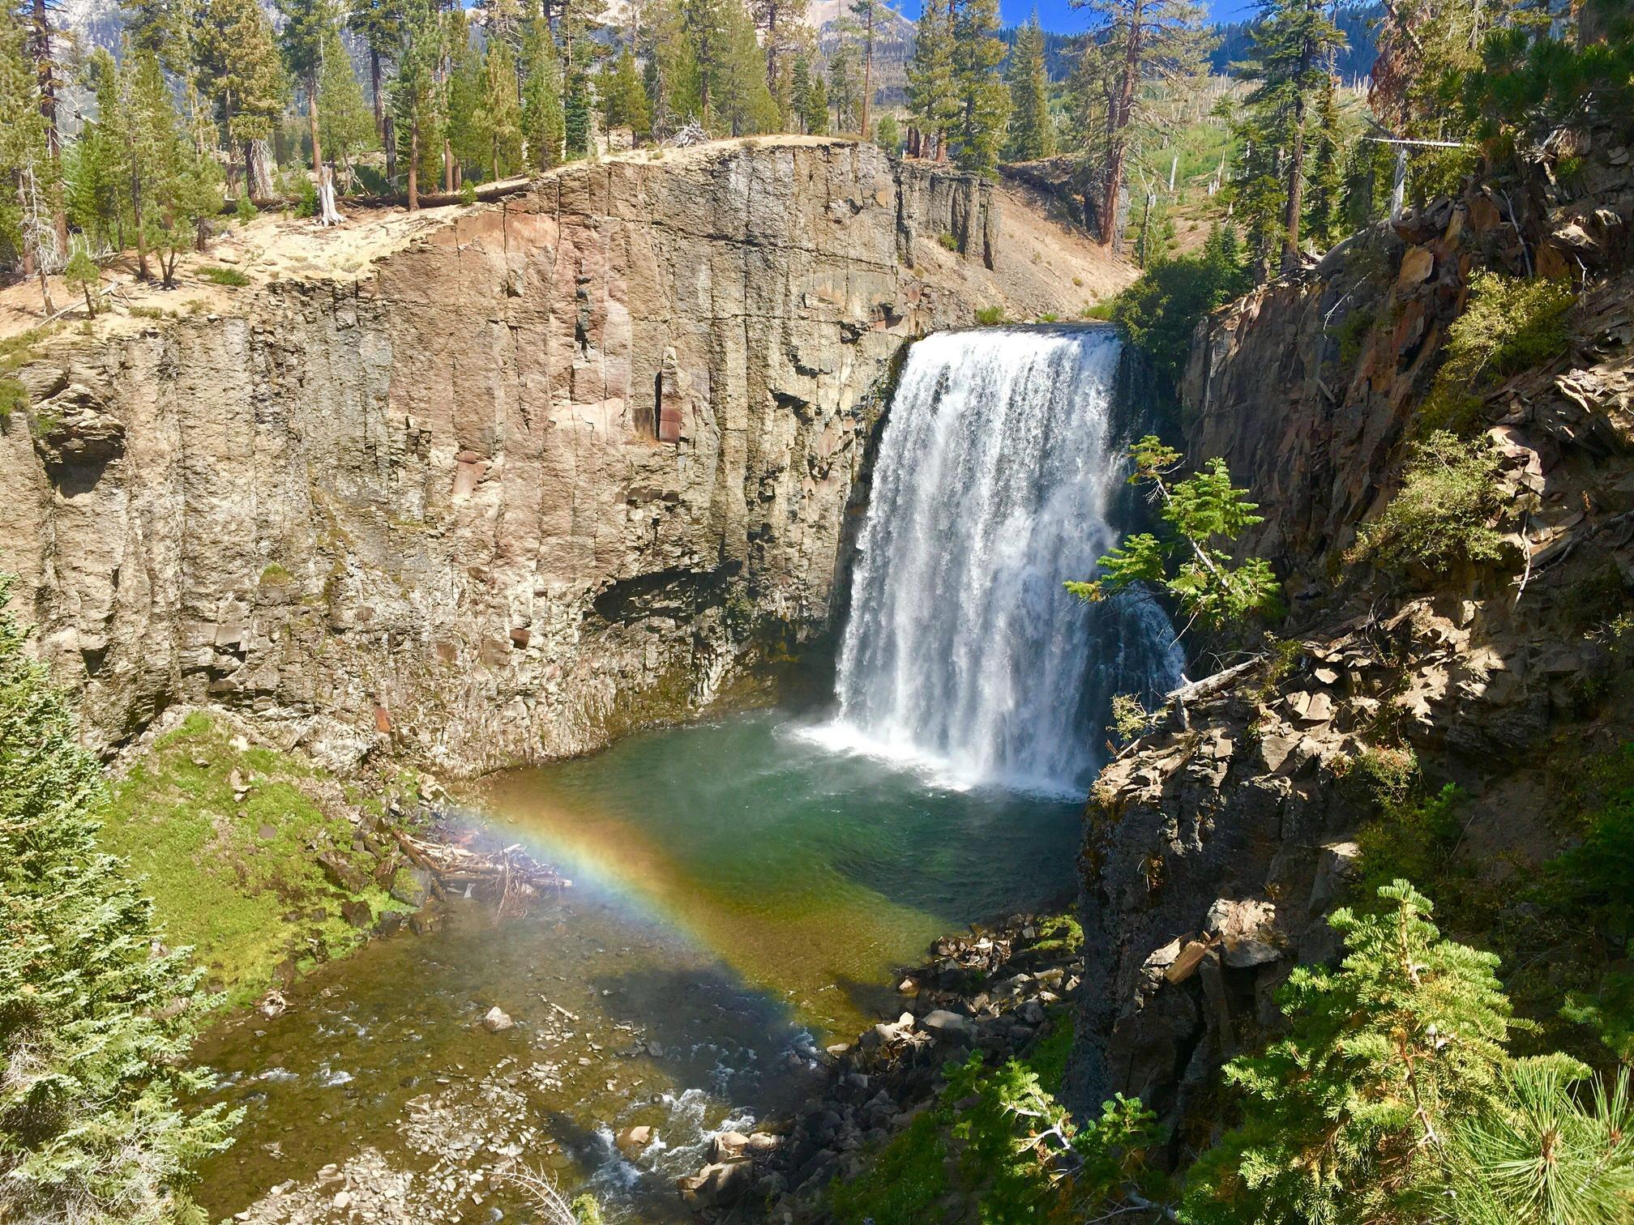
RAINBOW FALLS
REQUIRES A 1 ½ MILE EASY DOWNHILL HIKE
FROM DEVILS POSTPILE RETURNING UP HILL TO
SHUTTLE STOP 10 REDS MEADOW
RESORT FOR THE RETURN TO MAMMOTH
ICE CREAM AVAILABLE AT THE STORE.
REMIND THE GUESTS NO FOOD
ALLOWED ON THE SHUTTLES
Rainbow Falls is accessed by riding the Devils Postpile/Red’s Meadow Shuttle

